Slide 1
FIRST-ORDER (PREDICATE) LOGIC
Individual homework

Slide 2
Problem statement:
Exercise 7.3
Prove that the following formulas are not valid by finding anti-models for them.

Slide 3

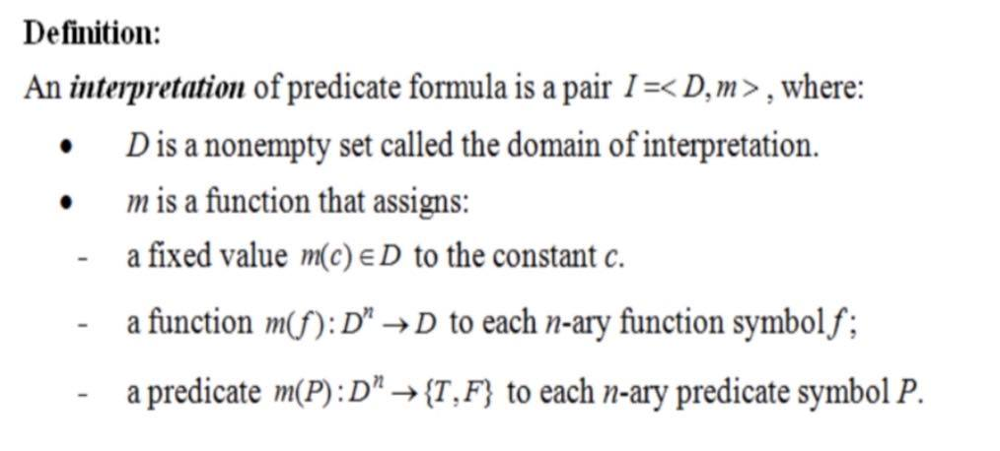
Theory

Slide 4
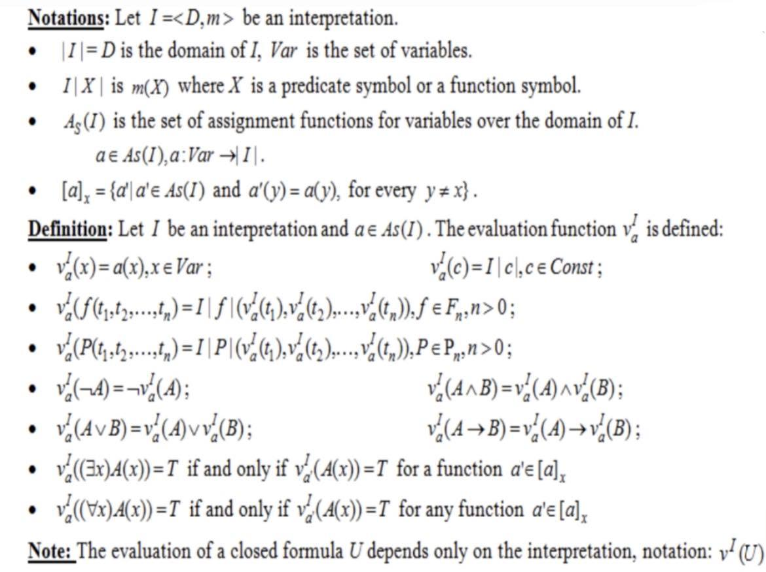

Slide 5
Solving
I have chosen an arbitrary interpretation with a finite domain ( with 2 elements) for the formula:
Let us chose an interpretation I = <D, m>, where:
D= {2,3} – the domain of interpretation
Let x ∈ {2,3}
m(P):{2,3} -> {T,F} m(P)(x) = “ x even”
m(Q):{2,3} -> {T,F} m(Q)(x) = “x odd”
To evaluate the formula U3 under the interpretation I, with the finite domain D = {2,3}, the universally quantified sub-formulas are replaced by the conjunction of their instances for x = 2 and x = 3

Slide 6
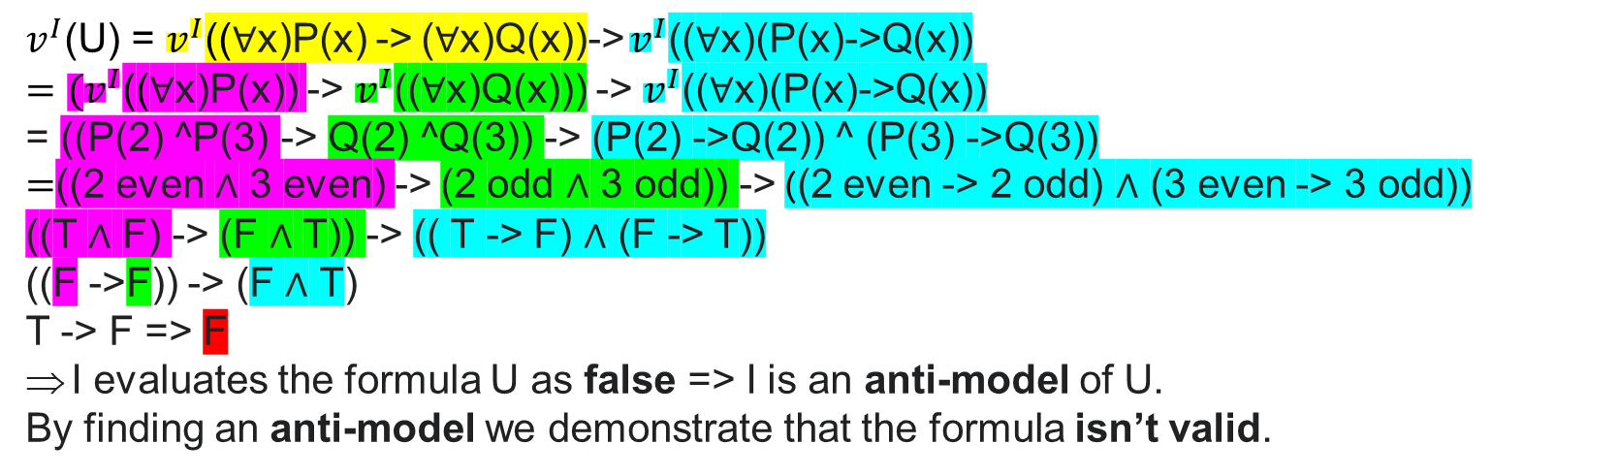
$v^{I}$(U) = $v^{I}$((∀x)P(x) -> (∀x)Q(x))-> $v^{I}$((∀x)(P(x)->Q(x))
$={(v}^{I}$((∀x)P(x)) -> $v^{I}$((∀x)Q(x))) -> $v^{I}$((∀x)(P(x)->Q(x))
= ((P(2) ^P(3) -> Q(2) ^Q(3)) -> (P(2) ->Q(2)) ^ (P(3) ->Q(3))
$=$((2 even ∧ 3 even) -> (2 odd ∧ 3 odd)) -> ((2 even -> 2 odd) ∧ (3 even -> 3 odd))
((T ∧ F) -> (F ∧ T)) -> (( T -> F) ∧ (F -> T))
((F ->F)) -> (F ∧ T)
T -> F => F
I evaluates the formula U as false => I is an anti-model of U.
By finding an anti-model we demonstrate that the formula isn’t valid.

Slide 7
Here’s something for the soul: https://www.youtube.com/watch?v=FvMA_kX_qjA
Realised by Iancu Gheorghe-Aurelian

